Slide 1
GEAR POSITION
Presented by: Vuong Huu Manh

Slide 2
AGENDA
Gear in automotive
Gear in Porsche J1PA

Slide 3
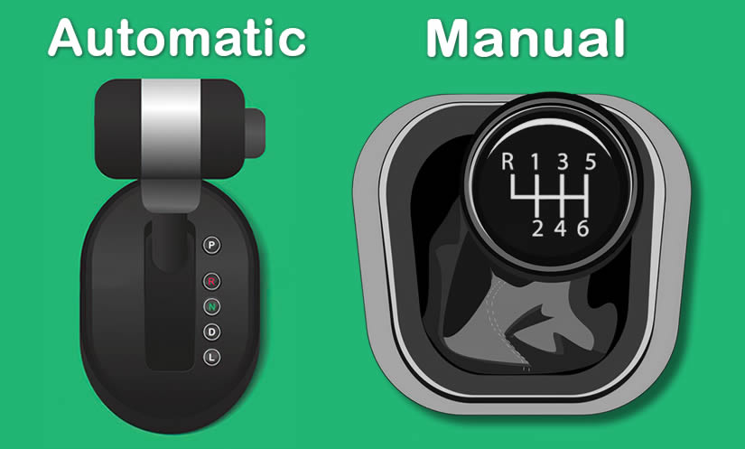
GEAR IN AUTOMOTIVE
Gears are a crucial component in automotive technology, enabling vehicles to transfer power from the engine to the wheels at varying speeds.
Types of gears: manual and automatic
Notes:
Với hộp số tự động hộp số sẽ tự động chuyển số - ưu điểm dễ dàng thao tác, không gặp tình trạng chết máy
Với hộp số sàn người điều khiển sẽ phải tự sang số bằng thao tác giữa chân ga và chân côn - ưu điểm giá thành rẻ, kiểm soát khả năng lái tốt hơn VD: đi đường đèo dốc
Source image: Difference Between Automatic and Manual Car - Learn Automatic (learn-automatic.com)

Slide 4
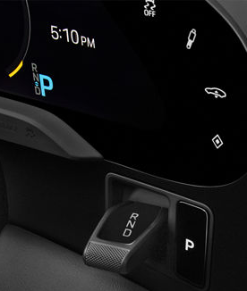
GEAR IN PORSCHE J1PA
The Porsche Taycan transmission is located on the rear axle and helps to optimize the car's performance at different speeds.
The first gear is used for quick acceleration and low-speed driving
The second gear is used for high-speed driving and better efficiency.
Gear position symbols mean:
D - Drive
R - Reverse
N - Neutral
P - Park
Notes:
D for driving forwards.
R for driving in reverse. Only engage while the vehicle is stationary and the brake is applied
N must be engaged while the vehicle is being transported or in car washes
P for securing the vehicle.
Drive positions D, R and N are selected using the selector lever to the right of the steering wheel, while drive position P is selected by pressing the P button.

